Slide 1
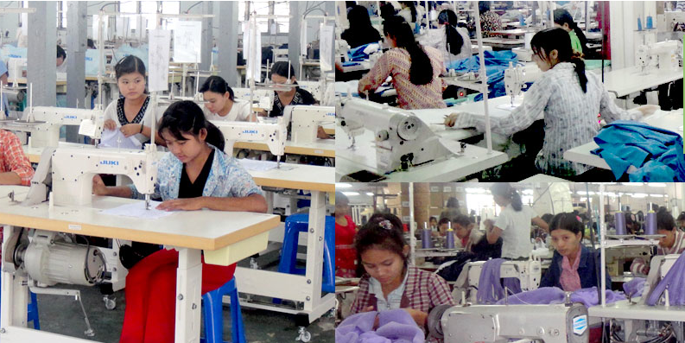
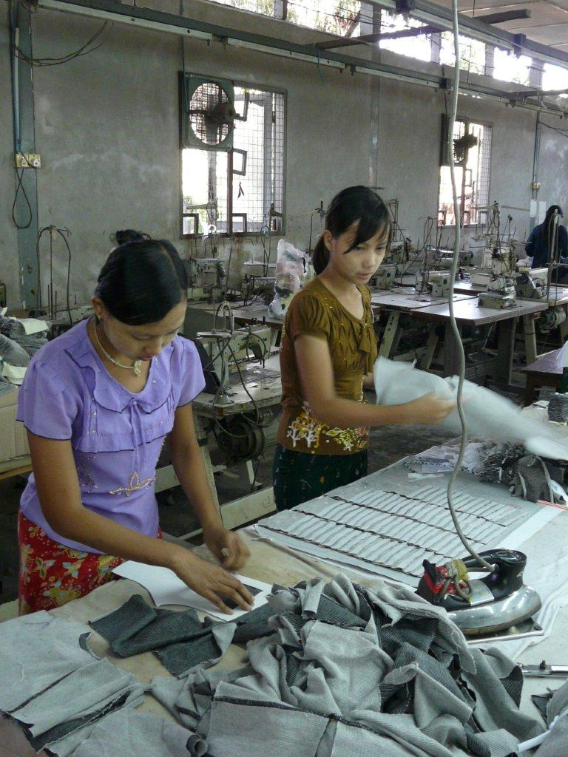
SMEs for environmental Accountability Responsibility and Transparency

Slide 2
Achievements SMART Myanmar

Slide 3
Table of content
What is SMART Myanmar?
Achievements
Challenges
Future outlook
Summary
Notes:
Simone

Slide 4
What is SMART Myanmar?
I
3 year project (2013 – 2015) financed by the EU with a budget of 2 Mio EUR.
Overall objective: to increase the competitiveness of SMEs in the garment sector of Myanmar and set preconditions for replication towards other sectors.
Specific objective: Production and consumption of sustainably manufactured garment from Myanmar is improved
Notes:
simone

Slide 5
What are the expected results of SMART Myanmar project?
MGMA offers services to promote and channel Sustainable Consumption & Production (SCP) effectively. (component 1)
Production of garments “made in Myanmar” is more sustainable. (component 2)
Myanmar’s garment factories increase exports to the EU markets. (component 3)
Notes:
simone

Slide 6
Our Partners
Lead Agency
Notes:
simone78 missions of know how transfer from EU to Myanmar, means arround 3 experts per month
Anual planing, dialuge, cooperation and shared mental model between all involved.
Introduce all SMART staff

Slide 7
Achievements
Component 1:
BMO capacity building and SCP awareness
Notes:
simone

Slide 8
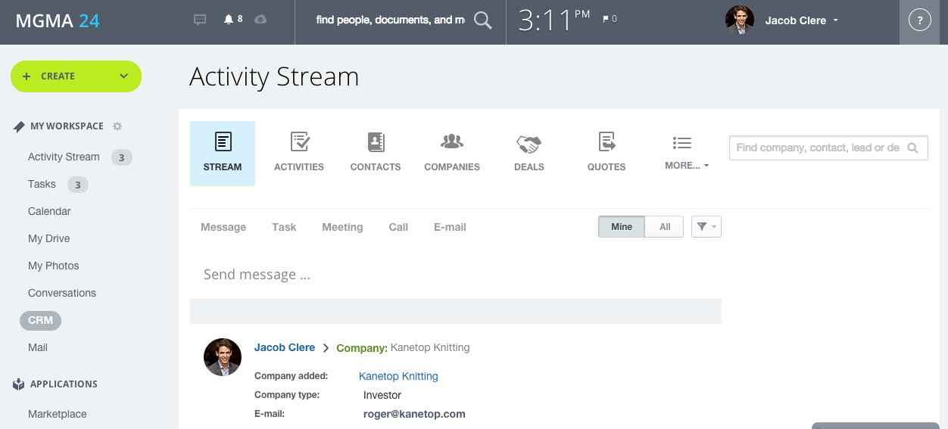
Activity cluster MGMA capacity building
Trainings and workshops conducted by Sheffield Chamber and sequa
Client Resource Management tool
MGMA staff titles and responsibilities
Enquiry handling system
Factory database facilitation
Notes:
Company intranet and Client Resource Management system introduced.
Replaces an inefficient paper-based system of meetings documentation.
To ease internal and external communication.
Facilitation of three projects which are harnessing factory data for use in an online e-matchmaking tool for MGMA.
Pyoe Pin: Survey database
IGC: e-import licensing database
SMART Myanmar B2B database
Events planning and management
Design & marketing concepts & techniques
Commercialization – Workshop with MGMA staff
Press releases

Slide 9
Membership Services of MGMA Achievements
Business matchmaking commercial service launched revenue generated for MGMA
Research services membership directory Sector research report launched and marketed
Capacity building

Slide 10
Membership Services of MGMA Achievements
Events and exhibitions factory awards MGMA participated in 2 international textile fairs
Web site www.myanmargarments.org 1100 viewers per week, most popular: labour law and regulations
Capacity building

Slide 11
Activity cluster SCP awareness raising
Awareness Campaign CSR > 3000 companies, sequa and ADFIAP
Study Mission to Germany – Sustainability Initiatives in Europe by t+m
Workshops/Training on Green Financing for 19 banks with 40 participants by ADFIAP
Notes:
The Launch to present the CSR Tools
Broadcast on several TV channels, internet news sites and printed press
Engaged high level policy makers in Myanmar and Europe
More than 150 SMEs attended and reached 700 (3000 planned) companies
Representatives from government ministries and business support organizations
Visited and have discussions with several Ministries, relevant business support organizations from Germany and Europe, consumer organizations as well as research institutes and companies.
participants got to know best practices in policy development, services as well as advocacy strategies regarding SCP, CSR and social dialogue in Germany and Europe.
Training/workshop has introduced the concept of SCP and its relevance to a total of 33 participants (representing 19 Myanmar Financial Institutions)
Has offered participants to do a hands-on evaluation of green projects
MBA looking into taking the approach of greening strategy in their lending procedures.

Slide 12
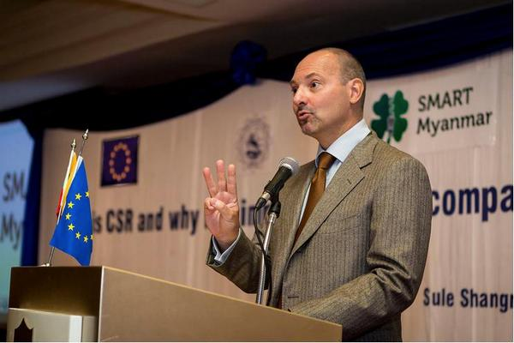
Awareness Campaign CSR > 3000 companies
EU Ambassador speaking about benefits of CSR

Slide 13
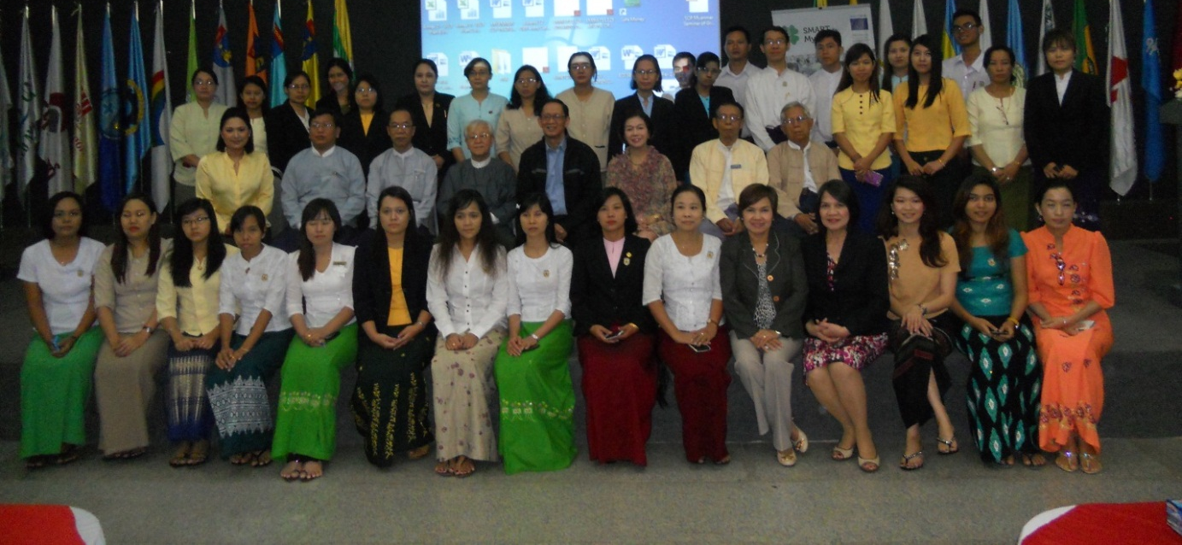
Green Finance Training
Achievement
19 banks participated in workshops on green financing to learn and adopt the greening strategy in their lending operations.

Slide 14
Achievements
Component 2:
Sustainable production
SMART compliance Academy
Productivity improvement program
Notes:
Theeri

Slide 15
Activity cluster SMART Compliance Academy
3 Workshops
factory owner & middle management (10 factories)
3 intense on-site consultancies (3 pilot factories)
Analysis of:
Designing of:
current compliance
necessary improvements
root-causes
corrective action plans
procedures and policies to sustainably improve good working conditions
Slide 15
Notes:
theeri

Slide 16
Topics compliance academy
Health and Safety
Precarious employment
Child Labor
Bonded labour
Protection of the Environment
Satisfied, healthy & safe workers
Remuneration & Bonus
Disciplinary Measures
Freedom of Association
Working Hours
Discrimination
Young Worker
Notes:
For now we will only present Health and Savety, other issues will be presented in the afternoon

Slide 17
Child labour
Before
After
No child labour protection policy
Formulated & documented child worker protection policy
Responsible person identified, step by step work procdure
Documents needed to verify actual age before hiring worker
Random check after new worker joins
Action to be taken if child labour is found
Workers age verification documents checked again after policy was established: age verification documents were kept in file
Special case migrant workers obtain doctors certificate

Slide 18
Remuneration and Bonus
Before
After
25 % labor fluctuation
5% labor fluctuation
+
+
+
Daily target
reached =
+ 1 hour
wages
extra
Company
outing
+
1 extra day
per year
New
Machines
(Technology)

Slide 19
Decent Working Hours
Maple
Before
After
12 hours per day
7 am – 7 pm (incl. break)
11 hours per day
7:30 am – 6:30 pm (incl. break)
-
1h
Same
wages

Slide 20
Occupational Health and Safety
General observations
Before
After
Some fire exits were blocked
Insufficient emgergeny lights
No regular checks of fire extinguisher
Inaccurate evacuation maps
No systematic approach to regular checks
All factories understood the requirements of systems
Established OH&S policies with detailed checklists
Made improvements
Continue to correct issues
Some factories passed certification

Slide 21
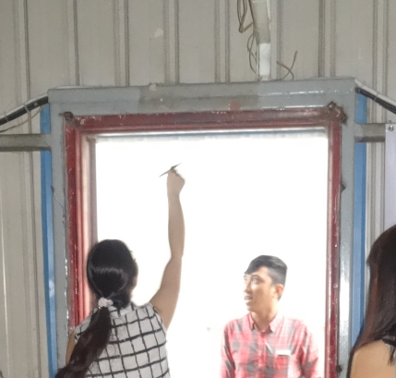
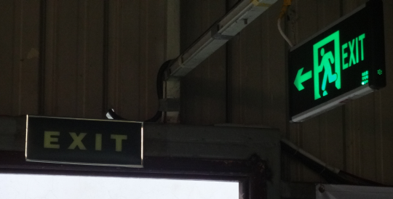
Emergency exits
Achievement
Before
After

Slide 22
Certification Support
Certification –
The Door to the European Market
Quality and social standards get more important in Europe
Important argument for consumer to buy
Certifications almost a “MUST” to start business
Notes:
Theeri, After this slide Ricky shall talk

Slide 23
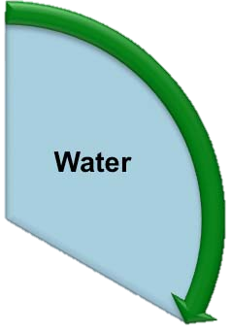
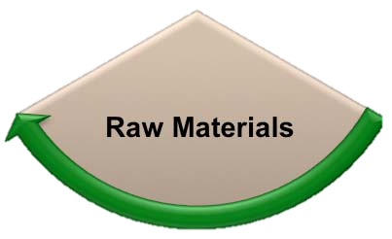
Activity cluster Consumption reduction
Reduction of lights, individual switches, training of workers
200 transportation boxes purchased and used to move goods around, 7 middle tables placed between sewing lines
Create optimum usage of fabric to achieve minimum wastage
Notes:
Vicky Min

Slide 24
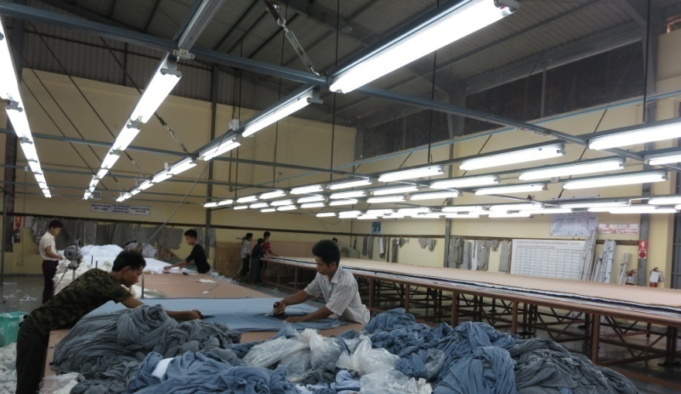
Consumption Reduction
Achievements
Before
After
Slide 24

Slide 25
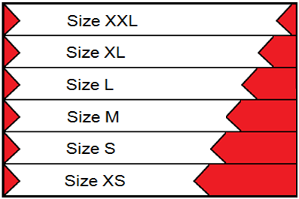
Consumption Reduction
Achievements
Before
After
Fabric
Wastage
Slide 25

Slide 26
Consumption Reduction of Resources
Achievements
Water
- 31250 L
Raw Materials
-18,3 %
Electricity
- 20 %
Total monthly savings which increase competetiveness

Slide 27
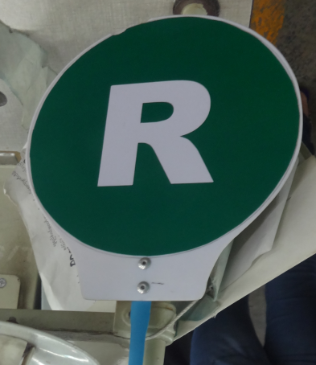
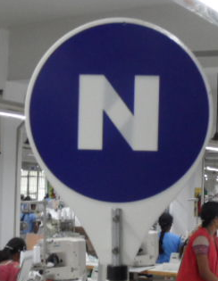
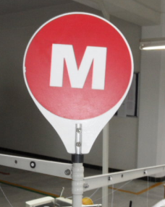
Activity cluster factory productivity
Standard Allowance Minutes (SAM) calculated
Pre-Production meeting and time table implemented
Factory lay out recommendations
Signs for immediate communication
Production planning software
Quality management
Notes:
April may

Slide 28
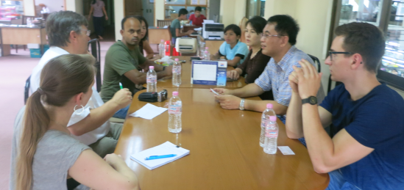
Optimizing Productivity
Achievements
Daily out-put quantity is reached in most lines
Machines occupied in sequence = no bottle necks
Production flow interruptions minimized
Managment informed about key performance indicators
+25 %
Productivity
Slide 28
Notes:
April may

Slide 29
Achievements
Component 3:
Export and Marketing

Slide 30
MGMA Code of Conduct
A voluntary standard developed by MGMA
Before
After
Based on ILO core conventions CoC developed with SMART to push compliance to higher standards
Minimum standards for Myanmar’s garment industry
Process for annual revision inbuilt
Some factories almost reach the standard
Road map to increase compliance under development
MGMA CSR desk as new service , expert hired
Whole industry lacked knowledge on labour, OHS and enviornmental standards
Myanmar industry envisioned guideline for the local context
T+m inputed draft CoC
Workshops were conducted
Notes:
U Mint Soe about the Code of Coduct which was written appropriately for the local situation and context. Winne to talk after this slides about her experience with the academy and how she discovered it is doable to implement good working conditions

Slide 31
National Export Strategy garment
The aim is to achieve full-stage manufacturing (FOB)
CMP
Develop the Style
Purchase fabric & accessories
Cut the Fabric
Make the garments
Trim/pack the garments
Ship the garments
FOB
Notes:
U Mint SoeNo local manufacturer is offering FOB; all do CMP only

Slide 32
Activity cluster: marketing and export
The aim is full-stage manufacturing (FOB)
Workshops, trainings on reaching to FOB
Price calculation
EU market requirements
Merchandise planning & actions
How and where to source?
Study Tour to EU “European Market & Buyer Requirements” (Trade Fair visits, B2B meetings) to gather sourcing knowledge
Training and coaching during first trial orders by EU buyers with selected manufacturers
EU Trade mission to Myanmar in March 2015 to create business contacts
Slide 32
Notes:
Theeir Orders placed in May 2014

Slide 33
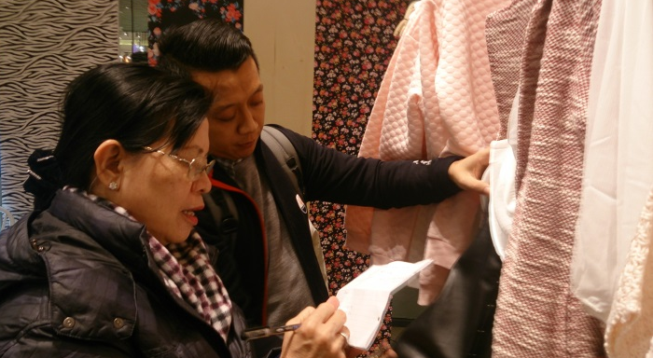
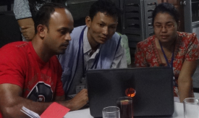
Export strategy: from CMP to FOB
First steps towards a major change
Achievements
Manufacturers’ awareness of global competitive pressure is increasing
Manufacturers’ knowledge in “from CMP to FOB” is improving
European business delegation of garment manufacturers visiting Myanmar with high interest to place orders
Slide 33
Notes:
theeri

Slide 34
Remaining challenges
Consistent policy framework on labour-related laws
Enforcement of the labour law
Legal framework conditions to reach to full scale business (FOB)
Lack of financial services, legal framework
Mind set of factory management / correlation between good working conditions and productivity;
Lack of local SCP services
Lack of skilled workers /vocational training
Social dialogue structures
Slide 34
Notes:
Simone
prevent child labor, enforcement of the labar law, lack of capacities to inspect the factories
Unfavorable payment transactions & import tax regulations: lack of duty exemptions on FOB inputs hinders the move from CMP to FOB

Slide 35
Replication potential SMART
The concept of SMART Myanmar
Pool of local experts on productivity and compliance in garment
Associations and chambers to generate income and introduce services to members
Tools like guidebooks, posters, videos
The voluntary Code of Conduct
CSR campaign
Compliance Academy
Productivity improvement catalogues
Production planning software
Matchmaking EU buyers to MM factories as a tool to increase OHS
Slide 35
Notes:
simone

Slide 36
Future outlook
Upscale SMART compliance academy to more factories, continue productivity enhancement program throughSCP consultants to support compliance with the MGMA CoC
MGMA compliance award
Forum with banks to prefinance orders (Letter of credit)
Continue cooperation with ILO on industrial relations and factory inspections
Close cooperation with EU brands/buyers factory training
Production of replication tools (guidebooks, vidoes, case studies)
Slide 36
Notes:
simone

Slide 37
Summary
Capacity building for MGMA = a success
Factories open minded to implement changes
Access to finance is vital for the industry to develop
Many promising steps were taken by all stakholders
Challenges remain (for local factories) to reach international standards
Intervention by many stakeholders needed
Slide 37
Notes:
Simone experience sharing between the Myanmar factories is vital, make the whole industry complient to the CoC, first steps were taken but more support is needed, long term relations between buyers and suppliers and management trainings for factories are needed

Slide 38
Thank you for your attention!
SMEs for environmental Accountability, Responsibility and Transparency
This project is funded by the European Union

